Slide 1
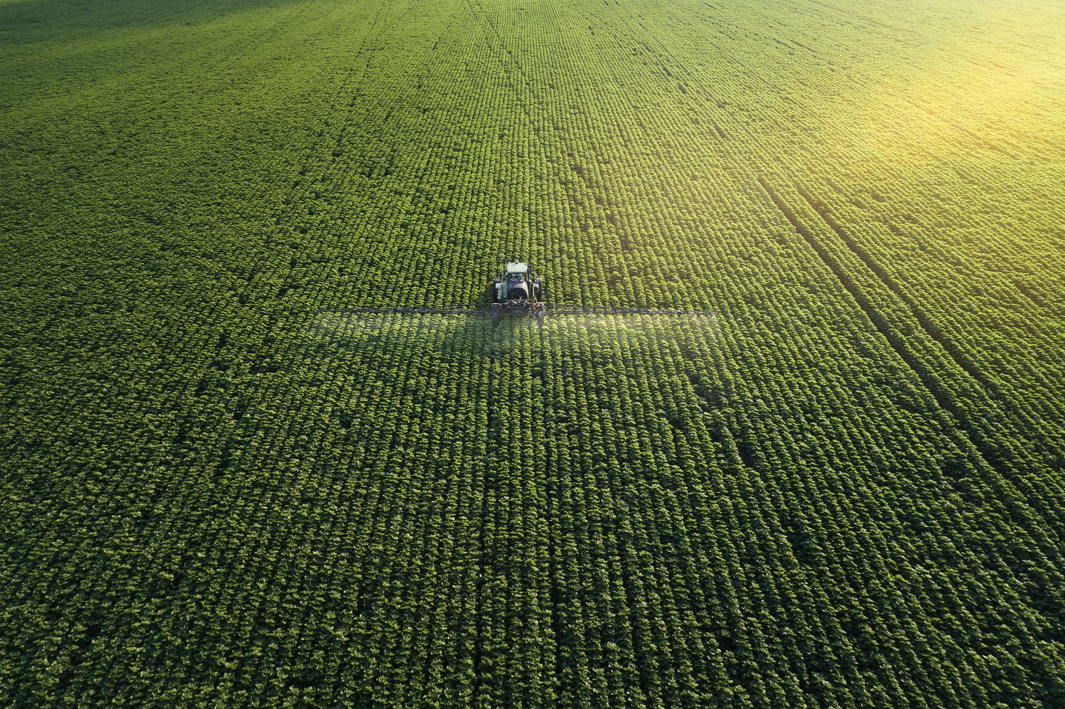
IOT BASED SMART FARMING SYSTEM USING NODEMCU8266
Guide: A2 Batch
Gopireddy Shiva Tejaswini 22255A0401
Dr.M.Vijayalakshmi Sareddi Sujitha-21251A0455
Associate Professor Narsannagari Hari Priya-21251A0421
Department of ECE P.Sathwika-21251A0450

Slide 2
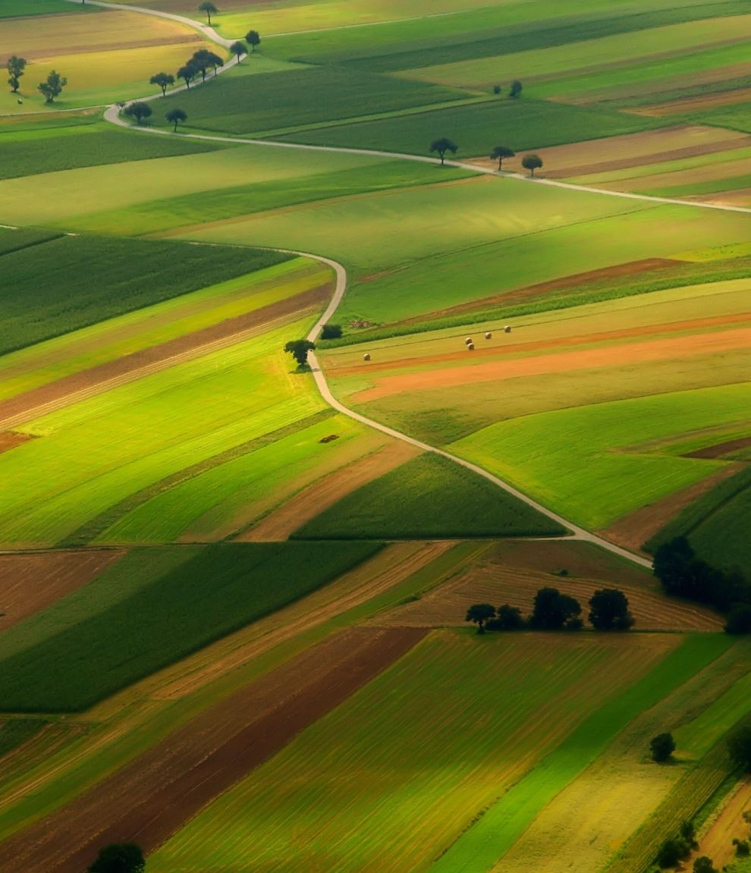
Contents
Existing system
Problem statement
Proposed method
Objectives
Block diagram
Literature survey
Hardware and software requirements
Advantages
Disadvantages
Applications
References

Slide 3
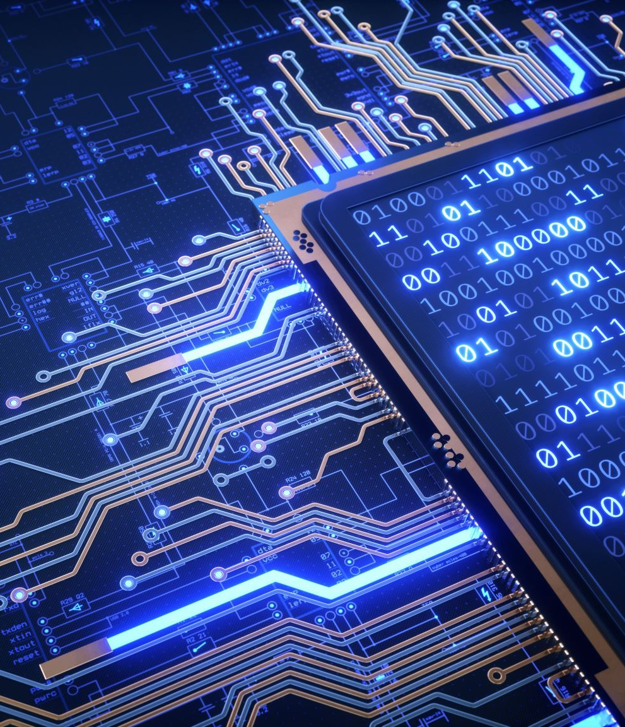
Existing System
IOT BASED SMART IRRIGATION SYSTEM USING ARDUINO
Existing System consists of GSM and GPRS modules to get information.
Arduino don’t have capability to send notifications.
Arduino need GSM/GPRS Modules.
There is no rain/ water sensor.
GSM/GPRS modules are very costly.
We can't receive updated notifications.

Slide 4
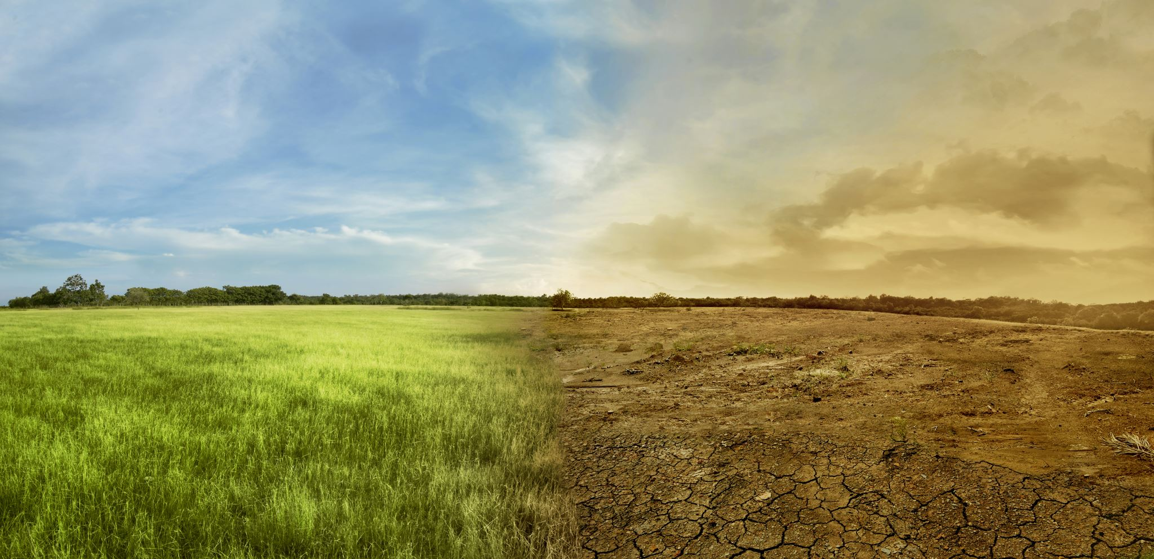
Problem Statement
To provide efficient decision web using wireless sensor network which handle different activities of farm and provides useful information associated with farm. Information associated with Soil moisture, Temperature and Humidity content. Due to the atmospheric condition, water level increasing Farmers get lot of distractions which isn't good for Agriculture.
Water level is managed by farmers in both Automatic/Manual using that mobile application. it'll make easier to farmers. Performing agriculture is incredibly much time consuming.

Slide 5
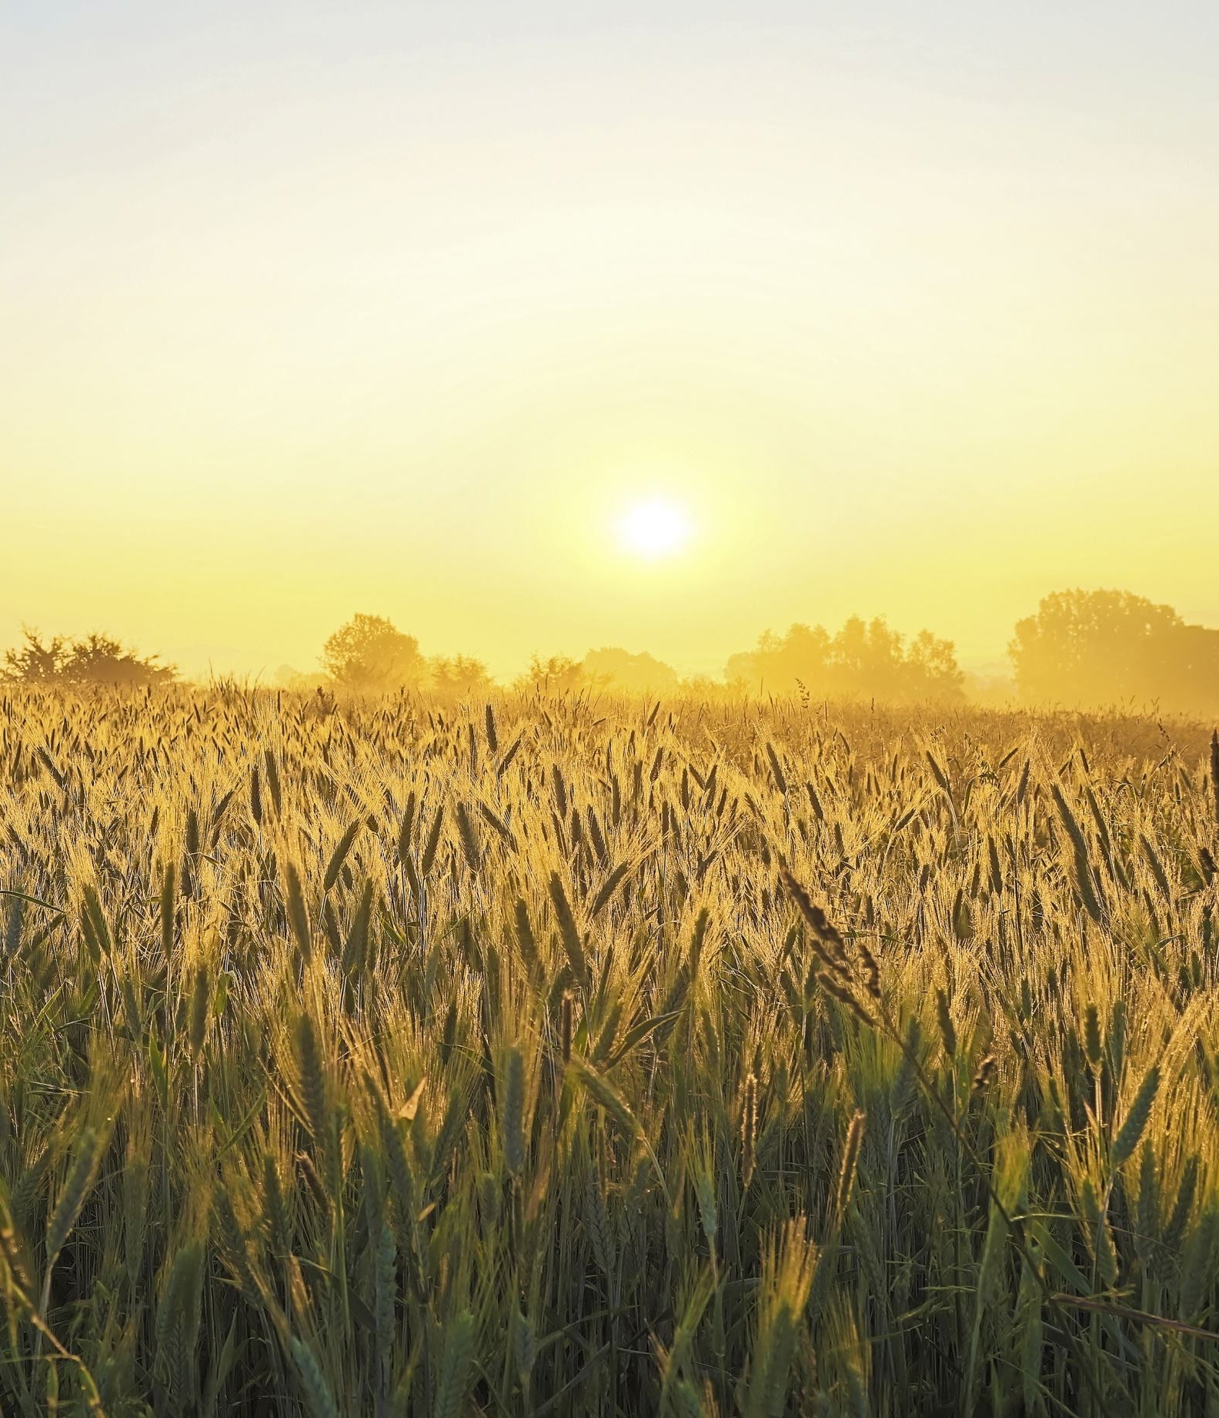
Objectives plants
Crop Monitoring
Weather Monitoring and Forecasting
Remote Control and Management
Energy Efficiency
Scalability and Flexibility
Education and Training
Cost-effectiveness

Slide 6

Proposed Method​
Design and implement an IoT-based Smart Agriculture System using NodeMCU ESP8266 microcontroller to monitor and manage agricultural parameters remotely. The system aims to optimize crop production,minimize resource consumption, and enhance yield quality by integrating various sensors and actuators with cloud-based data analytics.

Slide 7
RAIN WATER SENSOR
WIFI/CLOUD
NODE
MCUCU
POWER SUPPLY
RELAY
DHT-22
WATER PUMP
SOIL MOISTURE
SENSOR

Slide 8

Literature survey
IOT based smart sensors agriculture by Anand Nayyar and Er. Vikram Puri, November 2016 :This paper describes Internet of Things (IOT) technology has brought revolution to every and each field of common man’s life by making everything smart and intelligent.
A. Lakshmi, Y. R. Kumar, N. S. Krishna and G. Manisha, "IOT Based Agriculture Monitoring and Controlling System.This paper describes Internet of Things (IOT) technology using GSM/GPRS modules.
B. D. Thakare and D. V. Rojatkar, "A Review on Smart Agriculture using IoT," 2021 6th International Conference on Communication and Electronics Systems.This system automatically handles, a user requiring less manpower.

Slide 9
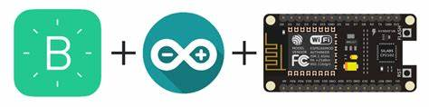
Hardware used
Node MCU 8266
Rain water sensor
Soil Moisture sensor
Relay
Water pump
DHT-22
Software used
Arduino IDE 2.3.2

Slide 10

Disadvantages​
Advantages
This system can provide a high accuracy water supply and avoid water from wastage.
This system automatically handles, a user requiring less manpower.
This system automatically handles the water supply (pump) to the field.
Lack of a strong internet infrastructure in rural areas.
Sensors and monitoring systems, is still unavailable to farmers without a dependable and steady internet connection.

Slide 11
Applications
The main application of a smart farming system is used for monitoring and controlling water software applications.
This system always helps to produce the best quality of crops and improves the economic condition.

Slide 12
References
[1] A. Lakshmi, Y. R. Kumar, N. S. Krishna and G. Manisha, "IOT Based Agriculture Monitoring and Controlling System," 2021 6th International Conference on Communication and Electronics Systems (ICCES), 2021, pp. 609-615, doi: 10.1109/ICCES51350.2021.9489198.
[2] B. D. Thakare and D. V. Rojatkar, "A Review on Smart Agriculture using IoT," 2021 6th International Conference on Communication and Electronics Systems (ICCES), 2021, pp. 500-502, doi: 10.1109/ICCES51350.2021.9489109.
[3] M. S. D. Abhiram, J. Kuppili and N. A. Manga, "Smart Farming System using IoT for Efficient Crop Growth," 2020 IEEE International Students' Conference on Electrical, Electronics and Computer Science (SCEECS), 2020, pp. 1-4, doi: 10.1109/SCEECS48394.2020.147.
[4] P. Kanupuru and N. V. Uma Reddy, "Survey on IoT and its Applications in Agriculture," 2018 International Conference on Networking, Embedded and Wireless Systems (ICNEWS), 2018, pp. 1-5, doi: 10.1109/ICNEWS.2018.8903969

